Slide 1

🛡️ The Invisible Hack: Attacking and Defending AI
Adversarial Machine Learning: Vulnerability and Robustness on MNIST
Presenter: Maheen Fatma | Course: Information Security
Roll Number : BITF22M031

Slide 2

Why AI Security Matters: Unmasking Digital Vulnerabilities
In the rapidly evolving landscape of artificial intelligence, securing our models against malicious interference is paramount. Our mission: uncover and mitigate the hidden weaknesses in AI systems.
Demonstrate CNN Vulnerability
We'll expose how easily a Convolutional Neural Network (CNN) can be fooled by cleverly crafted inputs.
Implement Adversarial Training
We'll then show how to build more resilient AI by training it to withstand these sneaky attacks.
Adversarial examples are like tiny "troll tweaks" to images – human-imperceptible changes that cause AI to go completely haywire! They are a major security risk.

Slide 3
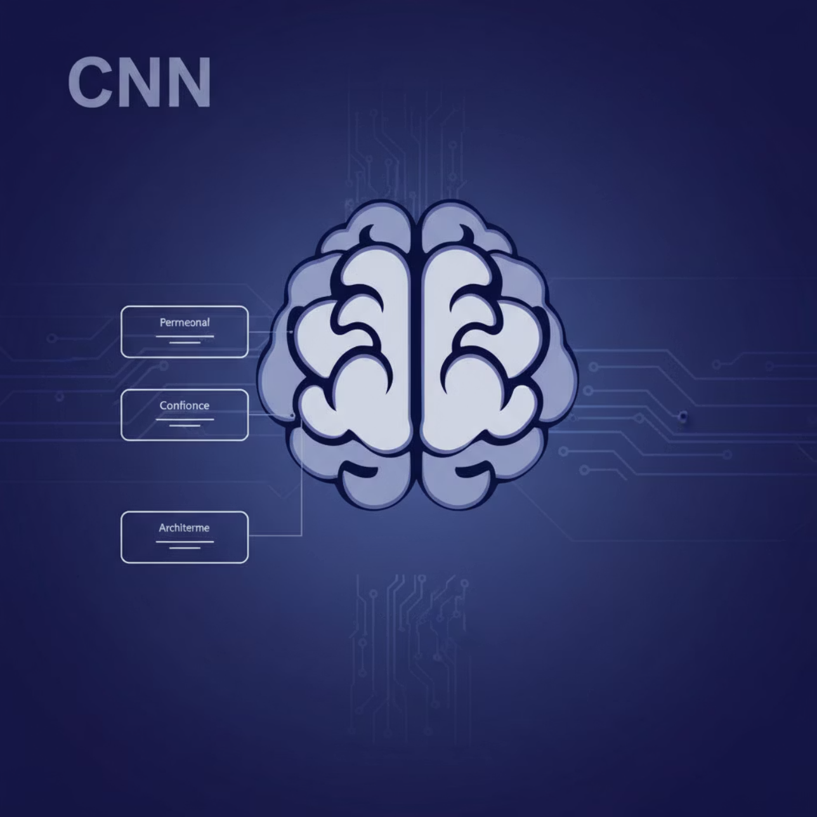
Our Target: The MNIST CNN
Our baseline model is a standard Convolutional Neural Network, trained on the classic MNIST dataset of handwritten digits. It's a stellar performer on clean data... or so we thought!
~99%
Clean Accuracy
When faced with normal, untampered images, our CNN correctly identifies digits with nearly perfect accuracy. Impressive, right? 🧐
But here's the catch: High accuracy on clean data ≠ invincible AI. Even the smartest models can be surprisingly fragile when faced with adversarial cunning.

Slide 4



The Attackers' Arsenal: FGSM & PGD
Meet the dynamic duo of adversarial attacks: Fast Gradient Sign Method (FGSM) and Projected Gradient Descent (PGD). They sound complex, but think of them as different levels of digital mischief.
FGSM: The Quick Hit
Like a digital phishing scam, FGSM makes a single, rapid, deceptive tweak to an image. Fast, efficient, and often effective.
PGD: The Brute Force Hack
This is the persistent exploit. PGD iterates many times, making small, calculated adjustments to maximize misclassification—a digital battering ram.

Slide 5
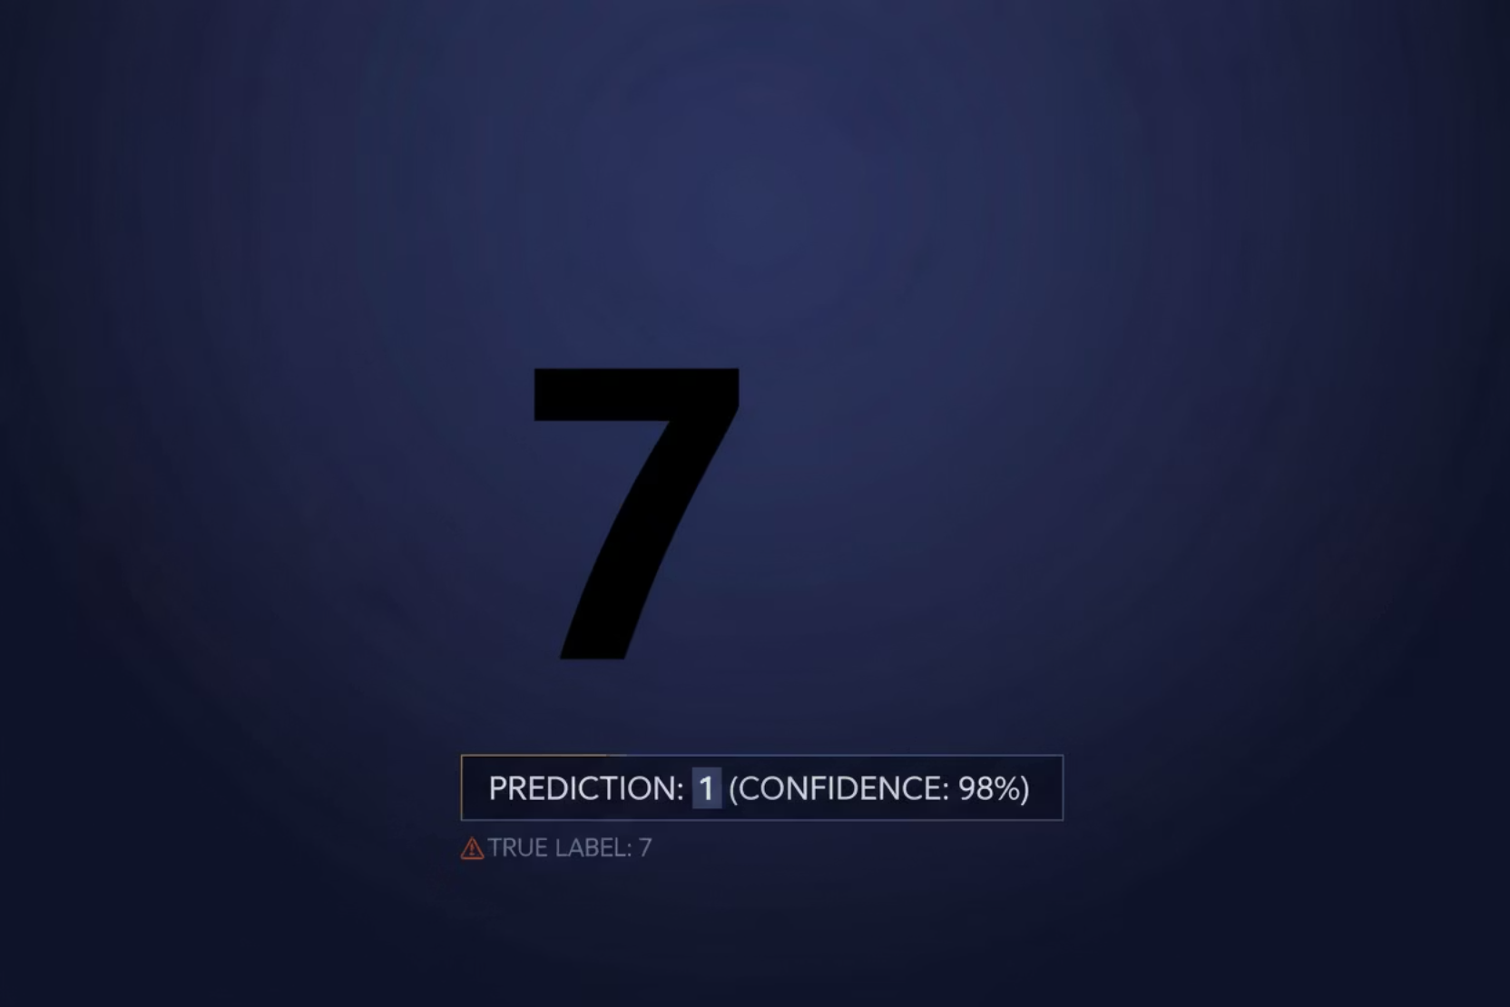
Vulnerability Results: AI's Achilles' Heel
The moment of truth! We unleashed FGSM and PGD on our highly accurate MNIST CNN. The results were... humbling. Our AI's confidence shattered, proving its clean accuracy was a deceptive façade.
Clean Data
99%
FGSM Attack
~20%
PGD Attack
<5%
PGD's impact is particularly startling: an accuracy below 5% is worse than random guessing for a 10-class problem! Our AI was utterly bewildered by seemingly harmless changes.
The attack is human-imperceptible, but for the AI, it's a completely different digit! 🤯

Slide 6
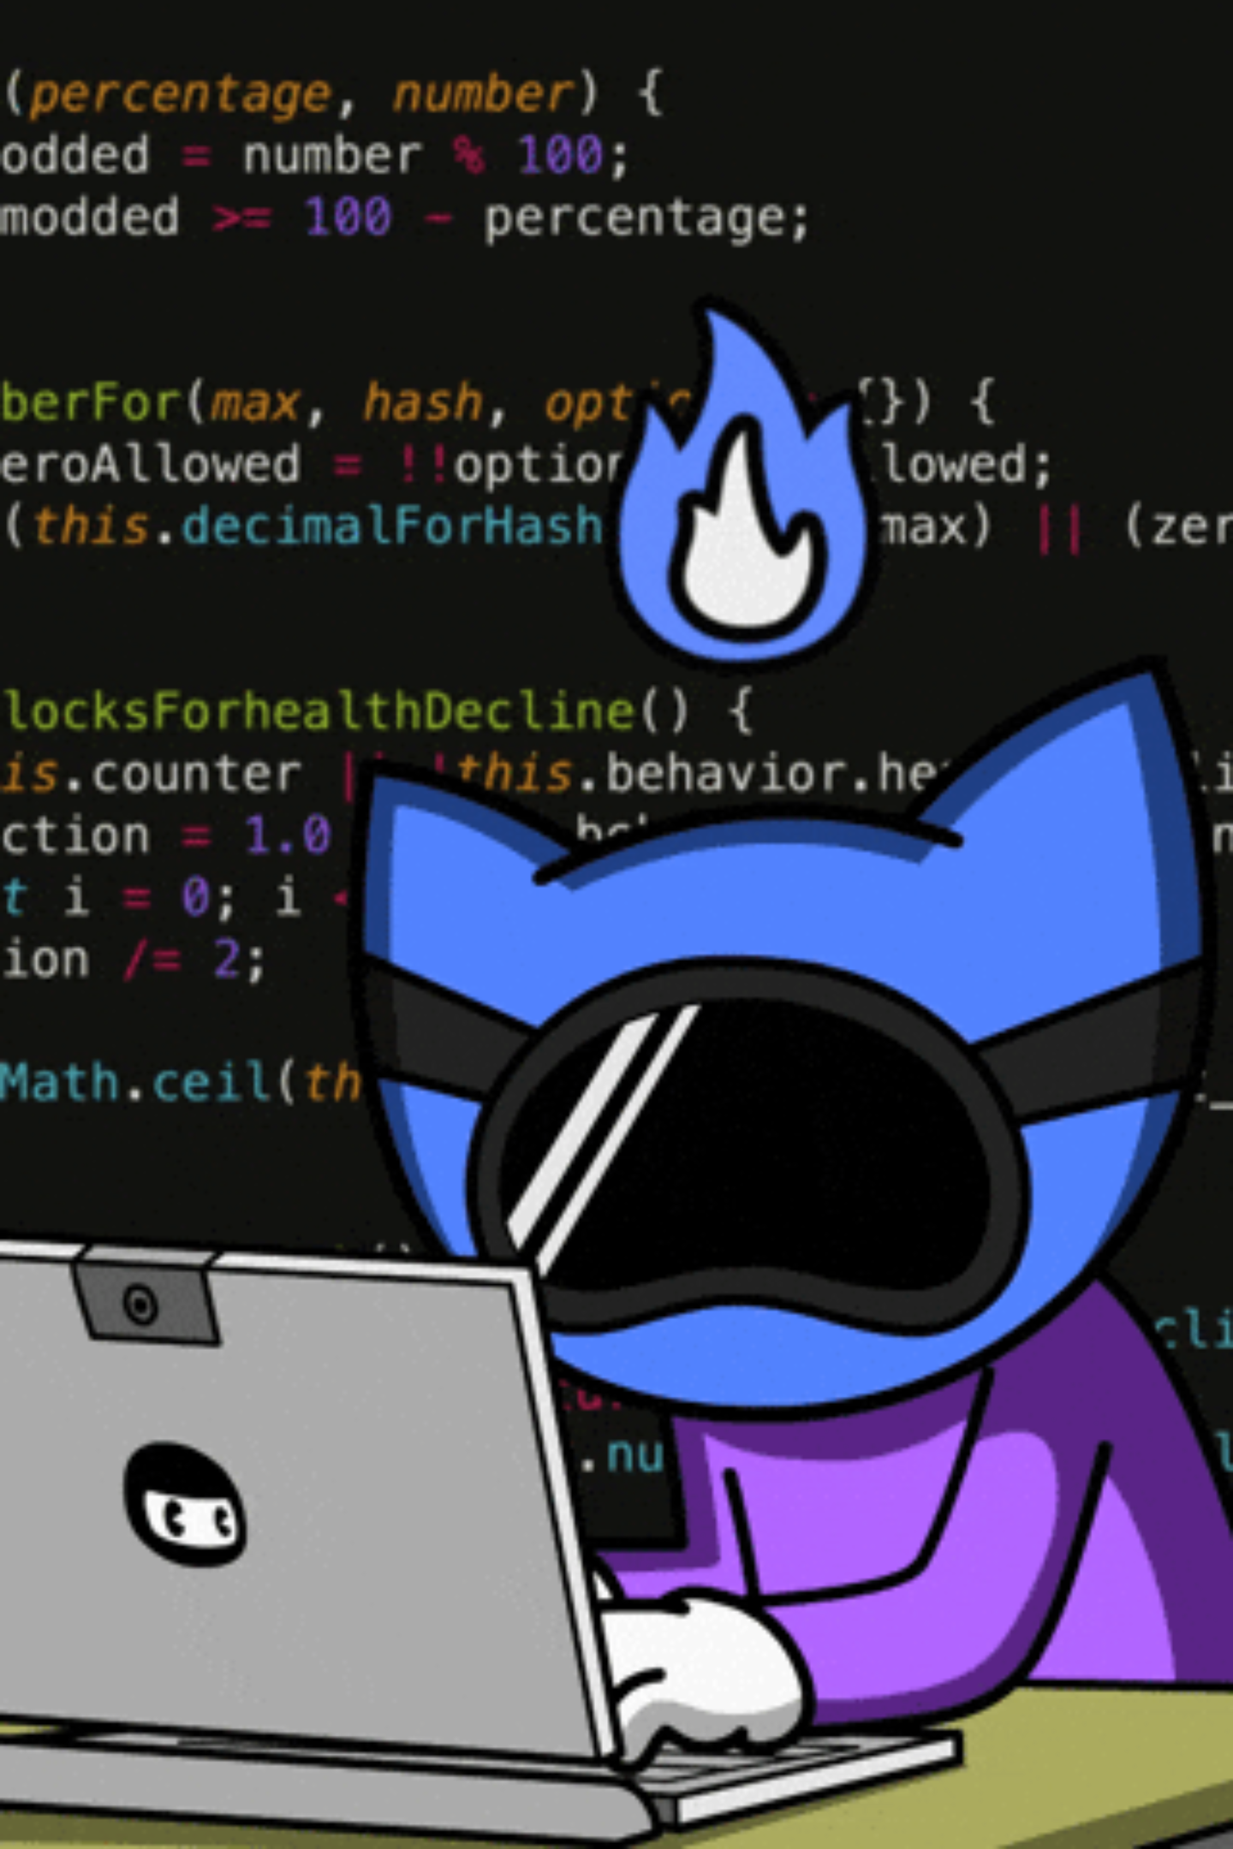

Defense Strategy: Adversarial Training
When under attack, you don't just patch the wall; you build a stronger one. Adversarial training is our AI's "cybersecurity bootcamp," teaching it to recognize and resist adversarial examples.
Generate Adversarial Examples
Train on Adversarial Data
The model is then trained on a mix of clean and these generated adversarial examples.
We create a batch of "bad" examples using techniques like PGD.
Build Robustness
This process forces the AI to learn a more robust, "messy" decision boundary, making it less susceptible to small perturbations.

Slide 7
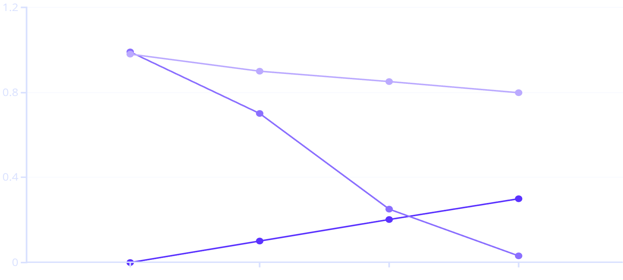
Robust Model Evaluation: The Trade-off
Adversarial training significantly boosts robustness, but it's not a free lunch. There's a subtle trade-off: a small dip in clean accuracy for a massive leap in adversarial resilience.
Clean Accuracy
99%
98%
PGD Attack Accuracy
<5%
~85%
We sacrificed ~1% clean accuracy for a whopping ~80% gain in robustness against the PGD attack! This strategic compromise makes our AI far more trustworthy in hostile environments.
Epsilon (Attack Strength)
Standard Accuracy
Robust Accuracy
The line graph shows the significant divergence in accuracy under increasing attack strength (epsilon).

Slide 8

Alternative Defense: Feature Squeezing
Another clever tactic against adversarial noise is "Feature Squeezing." Think of it as a digital filter or an input sanitization process that compresses the input space, making subtle adversarial perturbations disappear.
Color Depth Reduction
By reducing the number of distinct color values (e.g., from 256 to 8), we "squeeze" the image data, effectively smoothing out tiny, malicious pixel variations.
Spatial Smoothing
Applying filters like a median blur can also effectively remove the high-frequency adversarial noise, similar to how an image editor cleans up artifacts.
The idea is to eliminate dimensions where adversarial examples can easily hide, forcing them into a "squeezed", more interpretable feature space for the model. It's like blurring out the noise!

Slide 9
The Big Picture: AI's Future Defenses
Adversarial Machine Learning is a challenging but crucial field. We've shown that AI's vulnerability is real, but robust defenses are within reach.
Vulnerability is Real
Defense Works
Trade-offs Exist
Even highly accurate models can be easily fooled by imperceptible attacks.
Adversarial training significantly boosts model robustness.
Increased robustness often comes with a slight drop in clean accuracy.
Future Work: Beyond MNIST
Exploring black-box attacks where the attacker has no knowledge of the model's internals.
Scaling defenses to complex datasets like CIFAR-10 and larger models like ResNet-18.
Investigating new defense mechanisms and their impact on model interpretability.

Slide 10

Mission Complete: Adversarial Robustness is Mandatory
As AI becomes increasingly integrated into critical systems, ensuring its resilience against adversarial attacks isn't optional—it's foundational. The battle for secure AI continues! 🤖🛡️
Thank you!
Questions? Thoughts? Accusations of AI trolling? Let's discuss!

